Slide 1
www.risenenergy.com
RISEN ENERGY CO., LTD.

Slide 2
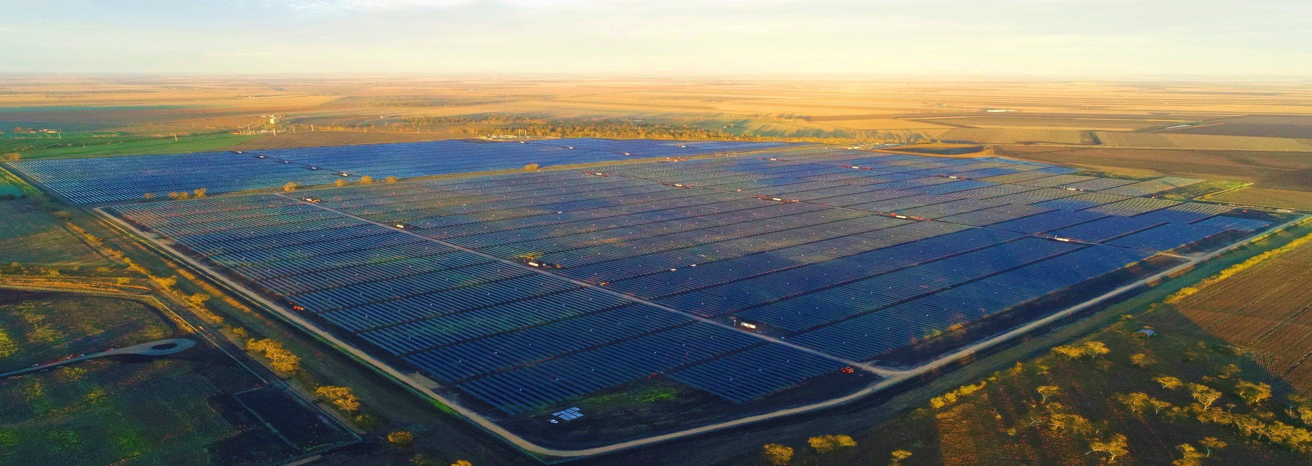
Contents
01 ESG Strategy
02 ESG Committee Organization Chart
03 Stakeholder Engagement & Appeal Mechanism
04 Social Responsibility Code of Conduct
05 EHS
Policy

Slide 3
01 ESG strategy
ESG strategy
Governance strategy
Climate strategy
Talent development strategy
© RISEN ENERGY CO., LTD. All Rights Reserved

Slide 4
ESG strategy
Focus on the field of green new energy, create an efficient, low-carbon and sustainable product model through technological innovation to continuously improve the energy structure, enhance life quality and contribute to green economic benefits for the society as a whole.
Governance strategy: Promote the cultural construction upon whole process of risk control.
Climate strategy: Ensure low-carbon production with green energy.
Talent development strategy: When recruiting talents, their jobs should be suitable for their talents and experience, possess both ability and political integrity, and put morality on the first place.

Slide 5
02 ESG Committee Organization Chart
ESG Committee Organization Chart
Responsibility Description
© RISEN ENERGY CO., LTD. All Rights Reserved

Slide 6
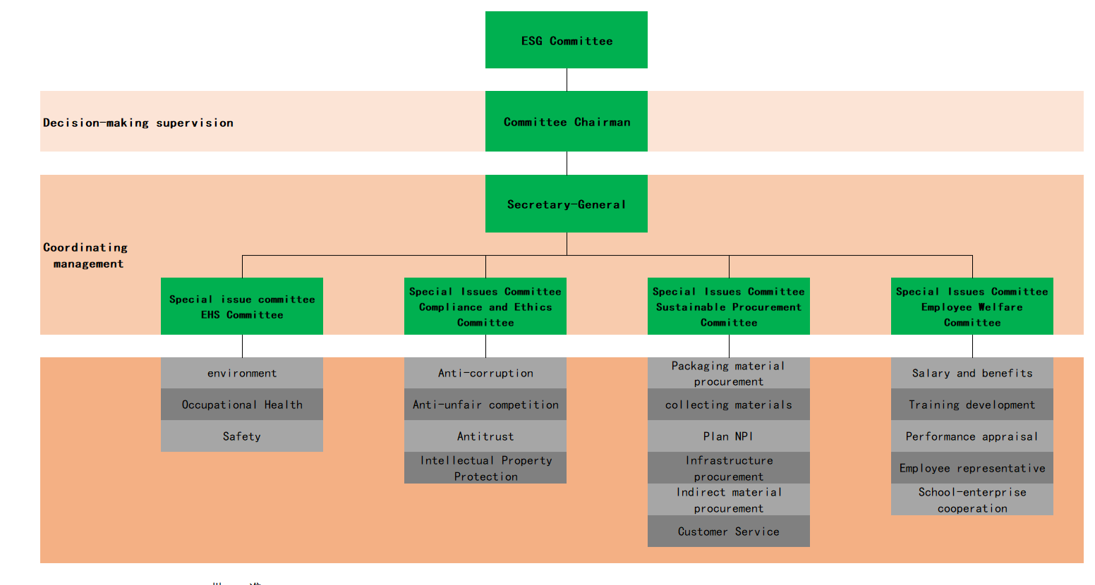
ESG Committee Organization Chart

Slide 7
Responsibility Description
Board of Directors Responsibilities
Planning, formulating and timely adjustment of ESG strategies and goals;
Review, make decisions on and approve major ESG issues;
Identify, evaluate and determine the company’s ESG risks;
Ensure the establishment of an effective sustainable development management system and risk monitoring system;
Examinate and approve the company's annual sustainability report;
Undertake management responsibility for the company's sustainable development, provide human, material and financial resources to ensure the implementation of sustainable development guidelines and policies.

Slide 8
Responsibility Description
ESG Committee Responsibilities
Coordinate and manage the company's sustainable development work and ensure the effective implementation of the sustainable development management system;
Responsible for regularly revising the sustainable development management manual and related procedural documents;
Responsible for communicating with internal and external stakeholders;
Responsible for identifying the company's major sustainability issues;

Slide 9
Responsibility Description
ESG Committee Responsibilities
Responsible for formulating sustainable development risk mitigation measures;
Responsible for the compilation and release of sustainability report;
Responsible for regularly reporting to the board of directors on the achievement of sustainable development goals and the status of risk management and control;
Other sustainable development related issues arranged by the board of directors.

Slide 10
Responsibility Description
Specific Issue Committee Responsibilities
ESG Committee has 4 sub-committees working on specific issues, EHS Committee, Compliance and Ethics Committee, Sustainable Procurement Committee, and Employee Welfare Committee, which are responsible for the management and implementation of every specific topic, as well as the implementation and promotion of every specific task.

Slide 11
Responsibility Description
Special Issues Committee Responsibilities
The representatives of each functional module from each specific issue committee shall regularly report to the leader of specific issue committee on the achievement of the goals and risk control status of the topics they are responsible for;
The directors of each specific issue committee shall regularly report to the chairman of the Sustainable Development Committee on the achievement of the goals of each specific topic and the status of risk management and control.

Slide 12
03 Stakeholder Engagement and
Appeal Mechanism
Public platform for stakeholder engagement
Specific platform for stakeholder engagement
Shareholder appeal mechanism
© RISEN ENERGY CO., LTD. All Rights Reserved

Slide 13
Public platform for stakeholder engagement
Receiving information from:
Public mailbox and telephone
The company's official social media homepage such as WeChat official account, etc.
Information classification, record and distribution
Result tracking & satisfaction investigation
Information reception window
Corresponding department responsible for the matter
Respond
Within 1 working day
Within 3 working days
Within 30 working days after responding

Slide 14
Specific platform for stakeholder engagement
Employee
Shareholder & Investor
Customer
Supplier
Partner
Government & Regulator
NGOs
Trade association & Industrial peers
Community
Environment
For employees：
Contract and employee handbook
Employee engagement survey
Employee training
KPI performance evaluation
Labor union activities
For customers (customer service department)：
Common work contact
Conduct regular customer satisfaction survey
For government and regulators：
Information disclosure
Provide access to company and factory access for external visits and inspections
Participate in the corresponding regulatory meeting
For the community：
Regularly organize community activities
Community satisfaction survey
For suppliers and partners (Procurement/Marketing department) ：
Common contact
Regular evaluation
For NGOs ：
Information disclosure
Provide access to company and factory access for external visits and inspections
For the environment：
Environmental data monitoring
Environmental standard compliance management
Greenhouse Gas Verification
For shareholders and investors：
Information disclosure
Common contact
General meeting of shareholders
Performance report (oral and written)
Investor communication platform
Field visit
For trade associations & industrial peers：
Regularly organize and participate in industrial seminars
Attend industrial exhibitions
Common contact

Slide 15
Stakeholder appeal mechanism
Whistleblower protection mechanism is implemented throughout the entire appeal handling process.
Stakeholder identification
Topic coverage
Appeal handling process
Employee
Discrimination
Appeal channel
Reporting email: 5198@risenenergy.com
Report hotline: 0574-59982178
Other online channels: Reporting QR code
Shareholders & Investors
Employee rights
The complaint receiving window classifies and distributes the appeal to corresponding department like:
Audit Department
Customer Service Department
Human Resources Department
Legal Department (Assistance)
Customer
Business complaint
Suppliers & Partners
Business ethics
Board of Directors
Government & Regulators
Compliance operation
Eligible for investigation
No
File archive
NGOs
Information protection
Yes
Report to Audit Committee or Board of Directors
Yes
Is it a serious case?
Within 30 days after report release
Trade associations & Industrial peers
Environmental protection
No
Community
Other ESG related matters
Investigation by specific team
Environment
Release investigation report & perform related measures

Slide 16
04 Social Responsibility Code of Conduct
General statement
Employee human rights protection
Safety and health
Environmental sustainability
Business ethics
Contribution to society
© RISEN ENERGY CO., LTD. All Rights Reserved

Slide 17
General Statement
Purpose: Risen Energy is engaged in production and operation in a responsible manner, and strictly abides by corresponding laws and regulations in all business operations. The establishment of this code of conduct aims to provide guidelines and standards for social responsibility compliance in company’s business activities, provide basic guidelines for employees’ behaviors and ensure the consistency between partners’ compliance performance and the value of Risen Energy.

Slide 18
General Statement
Purpose: In addition, Risen Energy is dedicated in reducing or eliminating the legal liability or related penalties caused by non-compliance behaviors, which may result in economic or reputation loss and other negative impacts and risks, to ensure the company's stable and standardized operations, leading the company's sustainable development.
Application scope:
All employees of the company
The company’s major partners

Slide 19
Employee human rights protection
The company strictly abides by the requirements from International Labor Organization and Chinese laws and regulations, and respects the human rights of employees, including but not limited to the following rights:
Prohibit forced labor
The company prohibits any forms of bonded or indentured labor, forced labor, slavery or servitude, or human trafficking. All work shall be done on employee's volition, and employees are free to resign or terminate their labor relations after providing reasonable notice.

Slide 20
Employee human rights protection
Legal employment
Only employees who have legal working rights is eligible to be hired, and employees’ working qualifications must be verified through relevant documents. Sign labor contracts with employees with compliance to corresponding laws and regulations of the country where it operates. All work performed by employees shall be based on the employment relationship established through national laws and facts under any circumstance.

Slide 21
Employee human rights protection
Child labor and juvenile labor
Never use or support the use of any child labor under the age of 16. If underage employees are employed, they will be guaranteed in accordance with relevant laws and regulations to ensure that they will not suffer improper physical risks during their employment, thereby harming their physical and mental health.

Slide 22
Employee human rights protection
Fair and equal treatment
Treat employees with respect and honesty, advocate the equality of opportunity, and eliminate any discrimination or harassment in the workplace (whether based on gender, race, color, religion, ethnicity, social background, age, sexual orientation, national origin, physical condition, political belief or any other characteristics protected by the law). The company does not tolerate any behavior that may constitute discrimination, offense, sexual harassment or other harassment, verbal or physical (or such threats) abuse, insult, or any other form of intimidation of employees.

Slide 23
Employee human rights protection
Freedom of association and collective bargaining rights
Comply with all applicable laws and regulations, and do not interfere with employees' right to freedom of association and collective bargaining. Employees are free to form, join, or withdraw from trade unions or similar legal organizations.
Working hours
Employees’ working and rest hours shall comply with all applicable laws and regulations. Any overtime should be done on employee’s own will, and employees’ overtime shall be paid in accordance with relevant national regulations.

Slide 24
Employee human rights protection
Remuneration and Benefits
The company provides employees with remuneration and benefits that meet the requirements of national laws and local regulations and shall inform all employees of labor conditions including remuneration in written form. Without the explicit consent of the relevant employees, their salary shall not be deducted without a legal basis, nor any form of discriminatory practices shall be adopted in matters such as employment and remuneration.

Slide 25
Safety and health
The company strictly abides by all relevant laws and regulations and spares no effort to ensure the safety and health of employees during all labor practices. In order to ensure a safe working environment, the company formulates and implements corresponding health and safety procedures based on the nature of activities in different facilities and sites. Every employee needs to be familiar with and abide by the company's health and safety policies and all related procedures, and is responsible for strict compliance with relevant safety instructions to maintain the safety and health of themselves and others. Once any accident or potential safety hazard is identified, or any deviation in the implementation of safety instructions, every employee shall immediately report to the relevant supervisor.

Slide 26
Environmental sustainability
The company is committed to conducting business in an environmentally responsible manner and embracing environmental protection in all business activities. By identifying and assessing the risks that operations may cause to the environment, actively seeking solutions to avoid or reduce the adverse effects of production and business activities on surrounding environment, and at the same time advocate and use various opportunities to expand the space for sustainable development. The company complies with all applicable laws and regulations, and encourages employees or related parties to immediately report to the company when they realize or suspect that a behavior is not responsible for environment or violates applicable laws and regulations.

Slide 27
Business ethics
Every employee shall follow the highest standards of ethics and integrity when carrying out daily business activities, and conduct business activities in an ethical manner in an open and transparent manner. Any behavior that may damage the company's reputation and interests, and violate ethics and integrity will not be tolerated.

Slide 28
Business ethics
Anti-corruption and commercial bribery
The highest standards of integrity shall be adopted in all company business interactions. The company has zero tolerance for all forms of bribery, corruption, extortion and embezzlement of public funds. Under any circumstance, the company and its employees shall not directly or indirectly provide, promise to provide, receive or solicit any valuables or benefits in the course of business activities to induce others to act in violation of the law or breach of integrity obligations, to acquire non-legitimate interests for the company or individuals.
Employees must not give money or any valuables to agents, intermediaries, business partners or other third parties, and must not use their work to request, accept, obtain improper benefits or accept the commitment of improper benefits.

Slide 29
Business ethics
Unfair competition
The company prohibits unfair competition behaviors such as non-fraudulent transactions, commercial defamation, infringement of trade secrets, participation in collusion, and mutual collusion, to create good environment and conditions for fair competition. Treat all partners fairly, and do not abuse their superior position to harm other party's interests or make unreasonable demands to embarrass other party.

Slide 30
Business ethics
Conflict of interest
Employees must always act in the best interests of the company, and must not use their position or any of the company’s property or information for personal gain, and must not improperly benefit any company or individual other than Risen Energy, or cause damage to the company or its customers. Employees should correctly handle the relationship between personal and company interests in accordance with the company's requirements, avoid conflicts of interest, and have the responsibility to formally inform the company's superiors of any conflicts of interest (actual, potential or perceived conflicts of interest).

Slide 31
Business ethics
Intellectual property
The company respects intellectual property rights and does not engage in or participate in any form of infringement, and takes appropriate measures to ensure and maintain their own intellectual property rights.
Information security and privacy protection
Employees should protect business secrets owned by the company and must not use such information for non-business purposes. Any information related to the company's business, which is not in the public domain is regarded as confidential information, and every employee is obliged to keep confidential of the business secrets and confidential information.

Slide 32
Business ethics
Information security and privacy protection
The company will adopt a formal and orderly process to ensure the smooth flow of information, and take corresponding measures to ensure and maintain information security.
The company respects the personal privacy rights of employees and other related parties, strictly abides by laws and regulations and company systems in obtaining, storing, using and disclosing personal information, and takes appropriate measures to protect personal information.

Slide 33
Business ethics
Information disclosure
The company will disclose relevant business activities, structure, financial status and operating performance information in accordance with relevant laws, regulations and regulatory requirements. Ensure the authenticity, accuracy, completeness and timeliness of information disclosure, and must not conceal, forge, or tamper with relevant records, or fabricate, provide, or disclose false reports and related information.

Slide 34
Business ethics
Appeals and reports
In order to standardize all aspects of the company’s operations and deal with the opinions and suggestions of employees and other stakeholders in a timely and effective manner, the company has established and disclosed a multi-channel appeal and reporting mechanism, encouraging employees and other stakeholders to report non-compliance, non-anonymously or anonymously.

Slide 35
Contribution to society
The company focuses on mutual support and cooperation with local governments (including legislative, administrative and judicial authorities), and actively develops constructive and strategic relationships with the government. The company attaches great importance to taking into account the public interests of the local community, so that the community can benefit from the company's actions. The company earnestly fulfills its social responsibilities, contributes to social and community public welfare undertakings, and shares the fruits of corporate development with the society. In carrying out business activities, avoid infringing on the interests of local communities and the public. The company is willing to listen to the concerns of the local community and actively respond when possible.

Slide 36
05 EHS Policy
© RISEN ENERGY CO., LTD. All Rights Reserved

Slide 37
EHS Policy
In the operation activities of the whole group, we always put safety in priority and implement the principle of safety first. We firmly adhere to this concept.
Employees are our most valuable assets. It is our consistent purpose to create a good working environment for employees and protect their health and safety.
Adhere to the culture of compliance, and promise to resolutely implement national regulations and standards in environmental protection, safety, fire protection, occupational health and other fields, and take compliance as the criterion.
EHS Policy
安全优先 生命至上 合规守法 绿色发展 全员参与 追求卓越

Slide 38
EHS Policy
Adhere to the principles of energy conservation, environmental protection and low carbon in commercial activities, promote carbon reduction and consumption reduction, and achieve green and sustainable development.
Through continuous input of EHS requirements, strengthen risk prevention, protect the vital interests of shareholders, employees and other interested parties, and achieve a win-win situation for all parties.
EHS Policy
安全优先 生命至上 合规守法 绿色发展 全员参与 追求卓越

Slide 39
EHS Policy
The participation of employees is crucial to EHS related activities and policy revision. We promise to build an enterprise safety culture with full participation and to establish an excellent EHS management system to promote continuous improvement.
Continuously organize relevant parties and employees to participate in environmental management training and drills, so that they can understand the environmental factors and protection measures of this work link, and achieve the effect of working together to reduce environmental impact.
EHS Policy
安全优先 生命至上 合规守法 绿色发展 全员参与 追求卓越

